Slide 1
Assignment for Image Recognition and Understanding
Report B: Segmentation

Slide 2
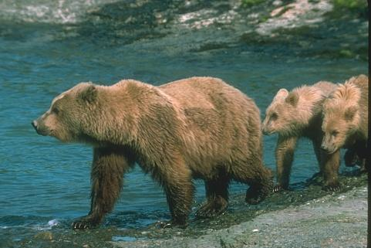
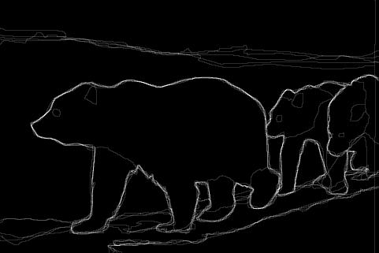
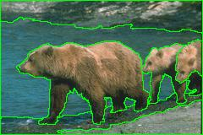
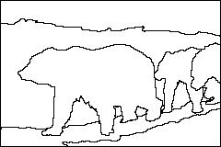
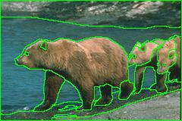
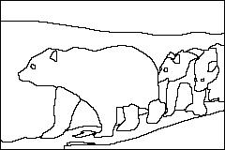
Image Segmentation
User A
User B
Different by human subjects

Slide 3
Database
UC Berkeley Segmentation Dataset 300 (500)
12,000 hand-labeled segmentations of 1,000 Corel dataset images from 30 human subjects
The images are divided into a training set of 200 images, and a test set of 100 images

Slide 4
Assignments
Applying 4 segmentation algorithm to detect border line to 5 color images:
Color Gradients
Brightness Gradients
Color K-Means (K is given by each page)
Mean Shift
5 images: 1-5 of https://www.eecs.berkeley.edu/Research/Projects/CS/vision/bsds/BSDS300/html/dataset/images/color/test-001-025.html

Slide 5
How to do that?
Matlab: Easy for calculation in Gradients, but K-mean and Meanshift has no built-in function
K-means: https://jp.mathworks.com/help/images/examples/color-based-segmentation-using-k-means-clustering.html
MeanShift https://jp.mathworks.com/matlabcentral/fileexchange/40990-mean-shift-pixel-cluster?focused=3803009&tab=function
OpenCV: All function has in built-in function but it is not install in our University environment.

Slide 6


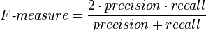
Evaluation
Use 3 evaluation method:
Recall
Precision
F-Measure
You can estimate best threshold for each score
 | actual class (observation)
predicted class (expectation) | tp (true positive) Correct result | fp (false positive) Unexpected result
 | fn (false negative) Missing result | tn (true negative) Correct absence of result

Slide 7
Reporting
You should report as http://grammar.yourdictionary.com/style-and-usage/report-writing-format.html
Do not write only result
You should think why this result and write them

